Slide 1

What Factors Lead to Motor-Related Accidents?
Nate Goenner, Aleena Nguyen, & Noah Friesen

Slide 2

Why is this Important?
According to the National Safety Council, an estimated 46,000 people were killed in motor-related accidents in 2022.
By finding the most impactful factors that could lead to motor-related accidents, we could reduce this number

Slide 3
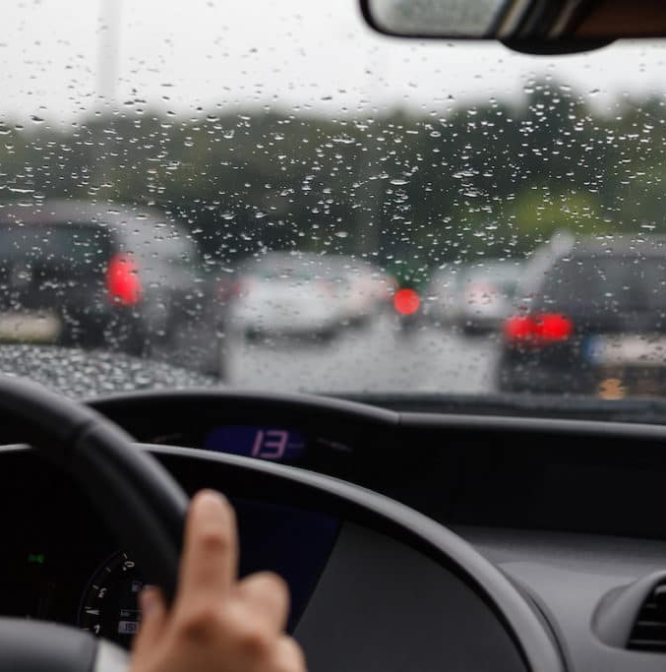
Hypothesis
Adverse weather conditions and drunk driving lead to the most serious car crashes.

Slide 4
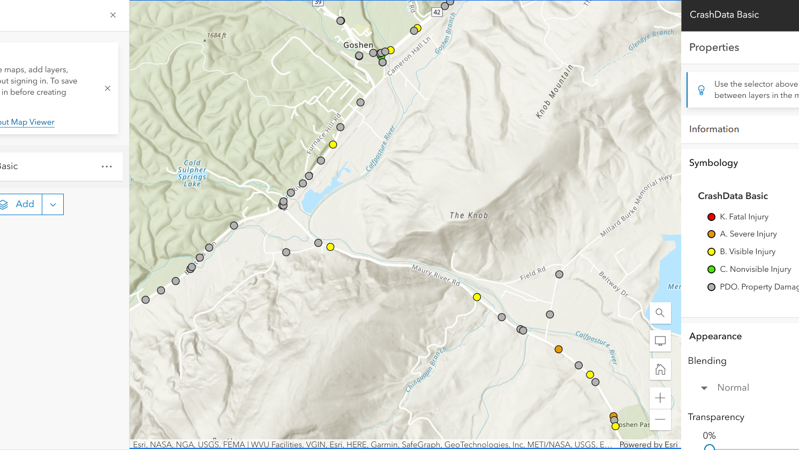
Dataset
Notes:
ArcGIS Hub Crash Data from the Virginia Department of Transportation
-Real time map
-Each of those dots is an accident

Slide 5
Data Cleaning
NON-FATAL: 0, FATAL: 1
NO SUSPECTED SERIOUS INJURY: 0, SUSPECTED SERIOUS INJURY:1
NO SUSPECTED MINOR INJURY: 0, SUSPECTED MINOR INJURY: 1
NO POSSIBLE INJURY: 0, POSSIBLE INJURY: 1
APPARENT INJURY: 0, NO APPARENT INJURY (PROPERTY DAMAGE ONLY): 1
PERSONS_INJURED
VEH_COUNT
COLLISION_TYPE: Human On Human: 0, Human On Other: 1
WEATHER_CONDITION: No Adverse Condition: 0, Adverse Condition: 1
LIGHT_CONDITION: Light 0, Darkness 1
ROADWAY_SURFACE_COND: Dry 0, Other 1
ROADWAY_ALIGNMENT: Straight 0, Other 1
ROADWAY_SURFACE_TYPE: Smooth 0, Rough
ROADWAY_DEFECT: No Defect 0, Defect 1
ALCOHOL: 1 NOTALCOHOL: 0
ANIMAL: 1, NO_ANIMAL: 0
DISTRACTED: 1 NOTDISTRACTED: 0
DRUG: 1 NODRUG: 0
SPEED_DIFF_MAX
SENIOR: 1 NOTSENIOR: 0
YOUNG: 1 NOTYOUNG: 0
Shrank from 800,000+ cases to 200
Removed date and year variables and NA values
Categorical data points to binary
Notes:
-6 response variables
-15 predictor variables

Slide 6
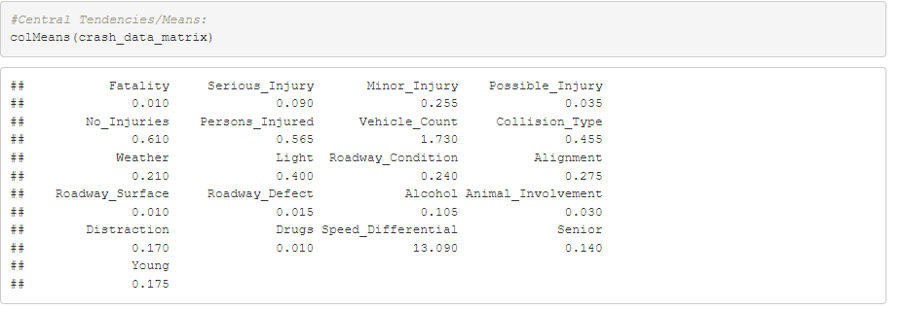
Measures of Central Tendency

Slide 7
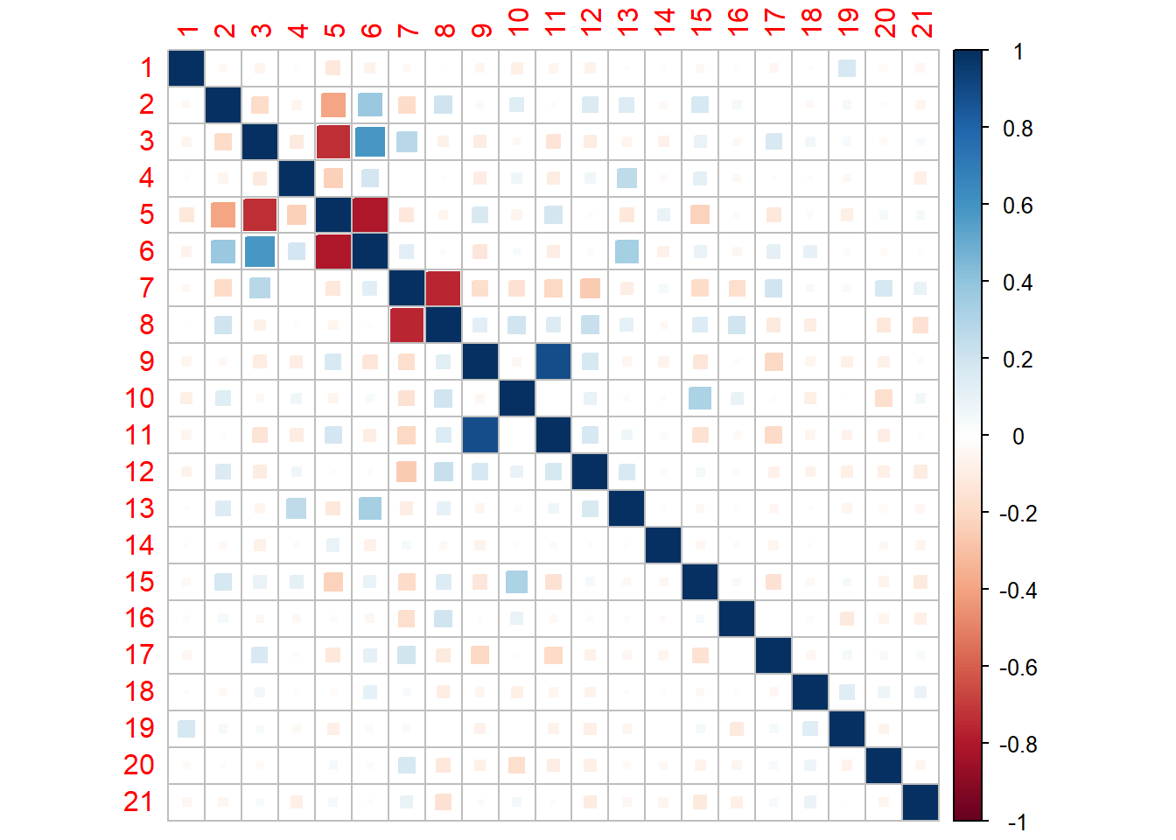
Correlation Matrix
Strong negative correlation between “vehicle count” and “collision type” (human-on-human coded as 0).
Strong positive correlation between “persons injured” and “roadway surface type.”
Relatively strong positive correlation between “light condition” and “alcohol use”.
Strong positive correlation between “road condition” and “weather condition”.

Slide 8
Predictor Variables:
Those_In_Collision
Speed _Component
Road_Type
Road_Defect
Speed_in_Day_Conditions
Impeded_Driving_and_Experience
Drunk_Driving
Ability_to_See
Response Variables:
Major_Injuries
Minor_Injuries
Fatalities
No_Injuries

Slide 9
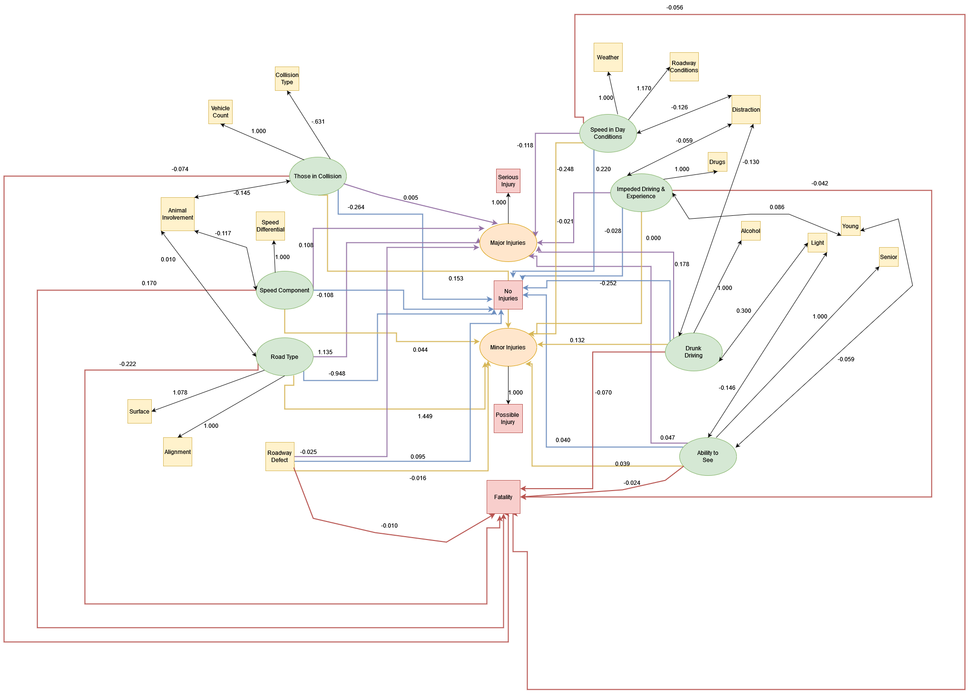
Path Diagram

Slide 10
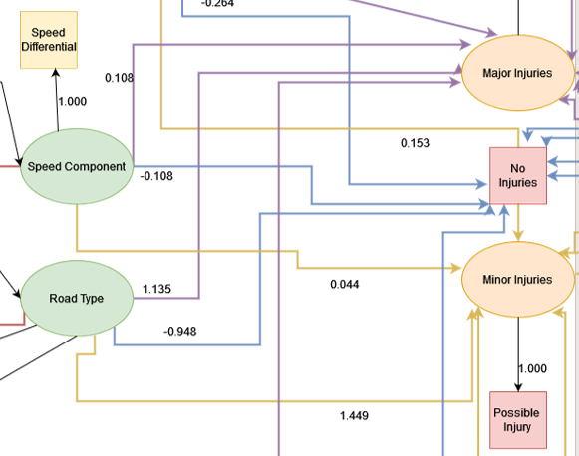
Largest Effects
The largest, significant effect was an estimate of 1.449 from Road Type to Minor Injuries. This can be interpreted as for every one-unit increase in Road Type, there was a 1.449 increase in Minor Injuries.
Although a large effect from Road Type to Major Injuries was seen, it was not significant (p-value = 0.107)
This suggests that rough and non-straight roads lead to more accidents causing minor injuries.

Slide 11

Limitations and What We Have Learned
Too many response variables and dimensions
Led to confusing path diagram and SEM

Slide 12
Future Implications
Infrastructure
Advocate for the development and maintenance of better road infrastructure, focusing on straightening roads and improving surface quality to reduce the occurrence of minor injuries.
Education
Promote comprehensive driver education programs, emphasizing the importance of navigating different road types to improve overall road safety.
Technology
Encourage the adoption of advanced vehicle safety technologies such as collision avoidance systems, adaptive headlights, and automatic braking to help reduce accidents caused by human error.

Slide 13
Questions?

